Slide 1


Smart City Project
Team Members:
Komal Harsha Dwarapu (12216924)
R Vivek (12204878)
L Sai Sandeep(12203080)

Slide 2
Project Description
The Project “Smart City” is a city that utilizes advanced technologies and data analysis to enhance the quality of life for its citizens.
It involves the integration of various information and communication technologies into the city’s infrastructure to optimize its operations, increase its efficiency and improve the delivery of its services.
This Application can be used by contractors of their respective fields who is having general knowledge about the basic operations and internet connectivity. This application provides a Login form to get the services. This can be categorized based on type of users.
The main aim of this project services provided to the users (contractors) to register their services at online platform. The services regarding Schools , Hospital, Road contract and services like Aadhar, PAN, Driving License cards . The admin will handle all this platform process smoothly and make necessary changes when error occurs.

Slide 3
Modules
Total Number of Modules : 3
Module Name
Administration Part by (R Vivek)
Infrastructure Part by (Komal Harsha)
Services Part by (L Sai Sandeep)

Slide 4
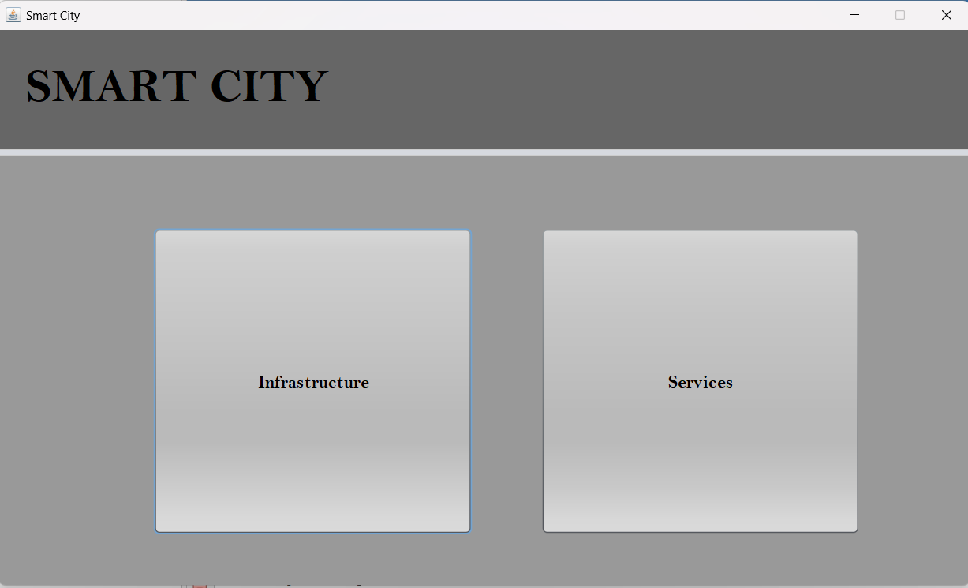

Slide 5
Administration Module Description
An admin module typically refers to a software component that provides administrative functions and capabilities to users with administrative privileges. The specific features and functionalities of an admin module may vary depending on the application or system it is a part of, but generally it is designed to allow administrators to perform various tasks related to managing and maintaining the application or system.
In this Smart City Project the Functions of Admin is :
1.Add user.
2.Update user.
3.Delete User.
4.View User.

Slide 6
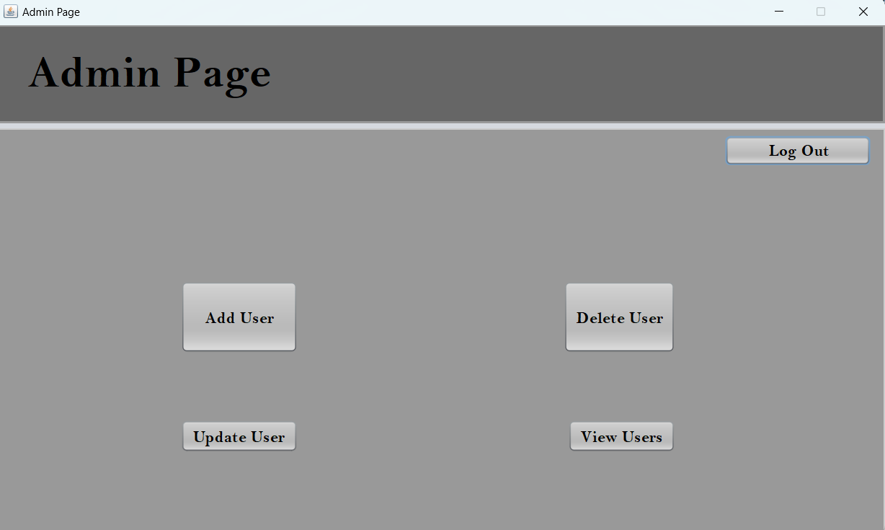
Modules of Admin:

Slide 7
Sub Modules of Admin
Add User: The Admin add the user by following these steps :
Log in to the system with administrative privileges.
Navigate to the section or page where you can manage users.
Click on the "Add User" or "Create User" button.
Enter the user's details, which may include their name, email address, username, password, contact information, and any other required fields.
Set the user's permissions and access rights based on their role and responsibilities.
Save the user details by clicking the "Save" or "Submit" button.
Notify the user of their account details, including their username and password, and provide any necessary instructions on how to log in and use the system.
It is important to ensure that the user details are accurate and up-to-date, and that the user's access rights are appropriate for their role and responsibilities. You may also want to set up a system for regular user account reviews to ensure that inactive or unnecessary accounts are removed, and that active accounts are still needed and have the appropriate access rights.

Slide 8
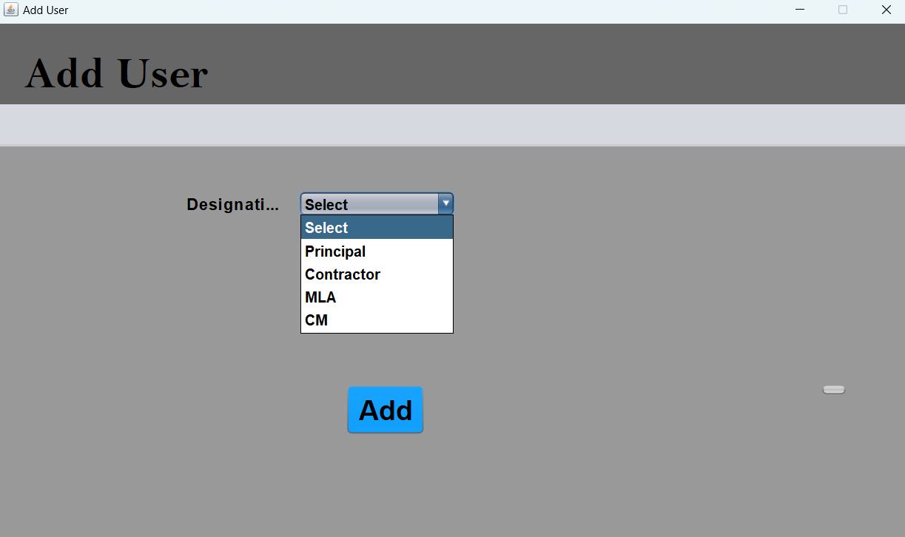
Add user:

Slide 9
Sub Modules of Admin
Update User : The Admin update the user by following these steps :
Log in to the system with administrative privileges.
Navigate to the section or page where you can manage users.
Search for the user whose details you want to update.
Click on the user's name or select the user from a list.
Locate the section or tab that contains the user's details, such as their profile or account settings.
Edit the user's details as necessary, which may include their name, email address, username, password, contact information, and any other required fields.
Update the user's permissions and access rights based on their role and responsibilities, if necessary.
Save the updated user details by clicking the "Save" or "Update" button.
Notify the user of their updated account details, including any changes to their username, password, or contact information.

Slide 10
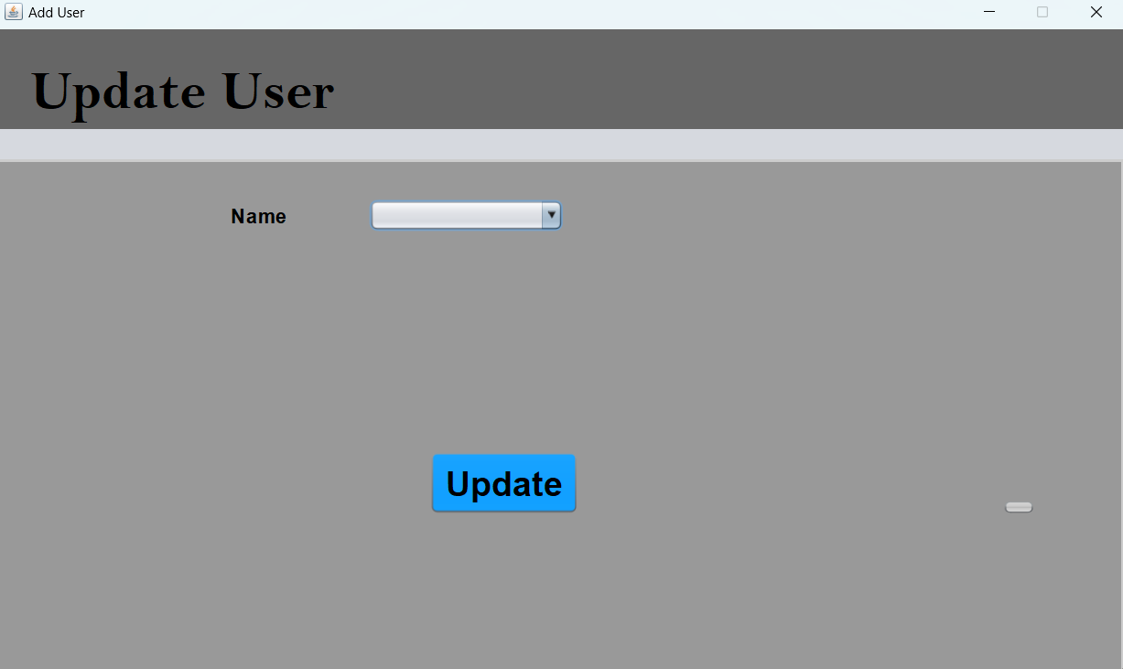
Update user:

Slide 11
Sub Modules of Admin
Delete User : The Admin will delete the user by following these steps :
Log in to the system with administrative privileges.
Navigate to the section or page where you can manage users.
Search for the user whose details you want to delete.
Click on the user's name or select the user from a list.
Locate the option to delete the user's account, which may be labeled as "Delete User", "Remove User", or similar.
Confirm that you want to delete the user's account by clicking on a confirmation button or entering a confirmation code.
If necessary, transfer any important data or files associated with the user's account to another user or location before deleting the account.
Notify the user that their account has been deleted, and provide any necessary instructions or assistance for them to retrieve their data or files.

Slide 12
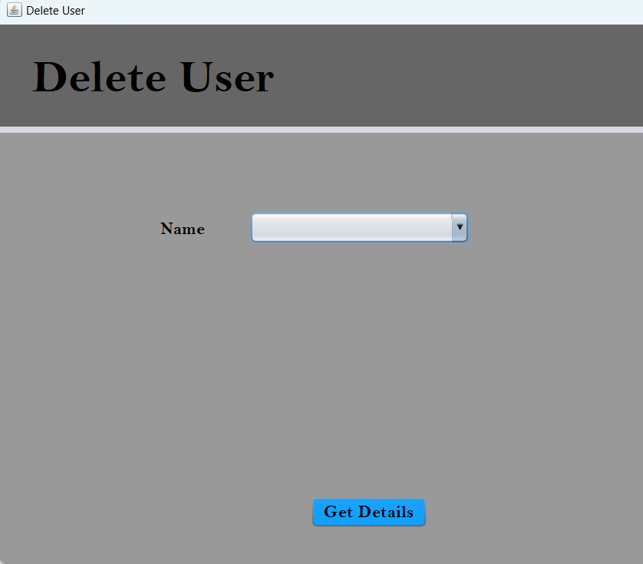
Delete User:

Slide 13
Sub Modules of Admin
View User : The Admin will View the user By following these steps :
Log in to the system with administrative privileges.
Navigate to the section or page where you can manage users.
Search for the user whose details you want to view.
Click on the user's name or select the user from a list.
The user's details should be displayed on the screen, including their name, email address, username, contact information, and any other relevant details.
If necessary, you can navigate to other sections or tabs to view additional details about the user, such as their activity logs, permissions, and access rights.

Slide 14
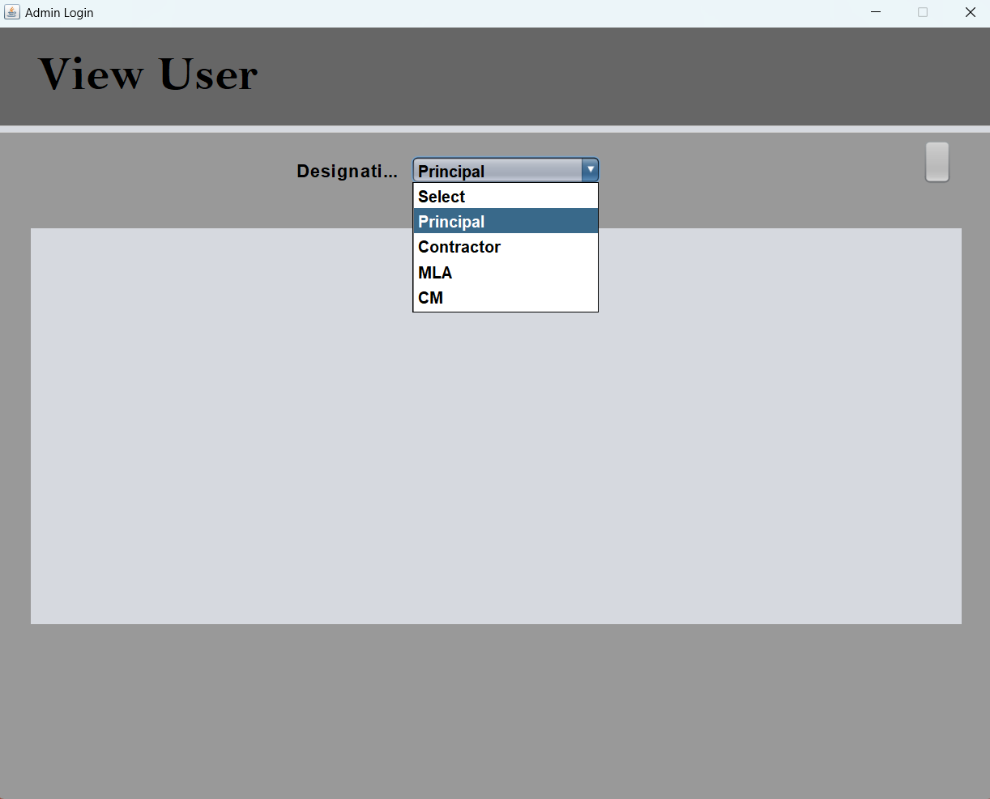
View User:

Slide 15
Infrastructure Module Description
In Infrastructure module Contractors can add buildings of their respective schools/colleges or any other shopping malls for approvals and that once he submitted the building required details to the application at first principal will go through the application and approve the application after that MLA will approve the application after looking all the details and verifying them then after getting approved the contractor will start the building plan accordingly. By this application platform all the process of approvals can be done online by this we can save time and in this smart digital era we must move forward and can the things have done with easy steps by using technology. The contractor can even check status of his approval.

Slide 16
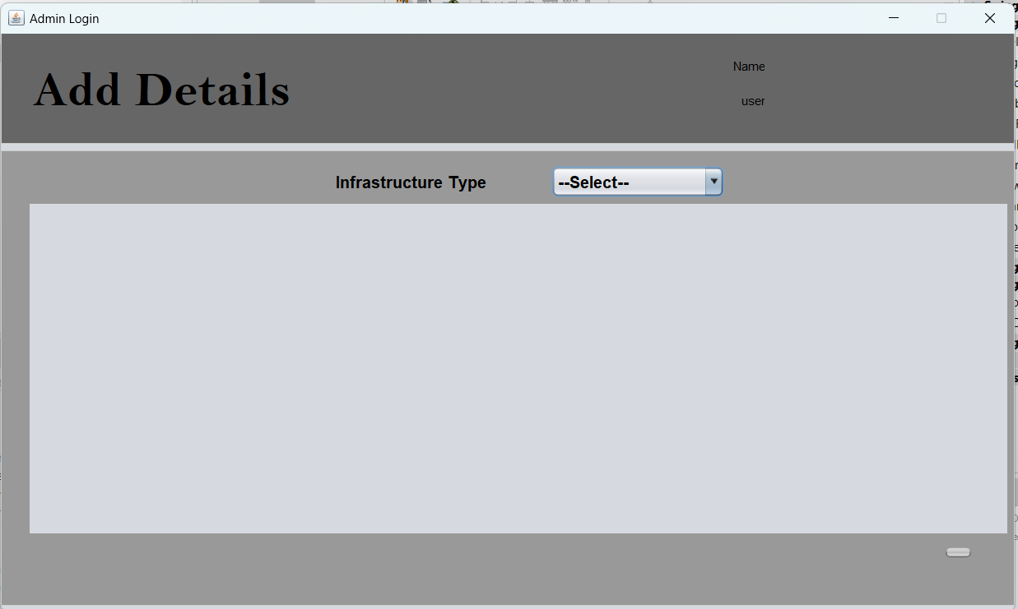
Infrastructure:

Slide 17
Sub Modules under Infrastructure
Schools: The government agency responsible for education will award a contract to a qualified contractor through a competitive bidding process. The contractor will be selected based on their experience, qualifications, and proposed bid amount and the contractor will be responsible for managing the project, adding the details like (School Name, School code, Area in Square meters, District) and also including scheduling, budgeting, and overseeing subcontractors and workers. They will also be responsible for ensuring that the construction site is safe and secure, and that all work is done in compliance with local building codes and regulations.

Slide 18
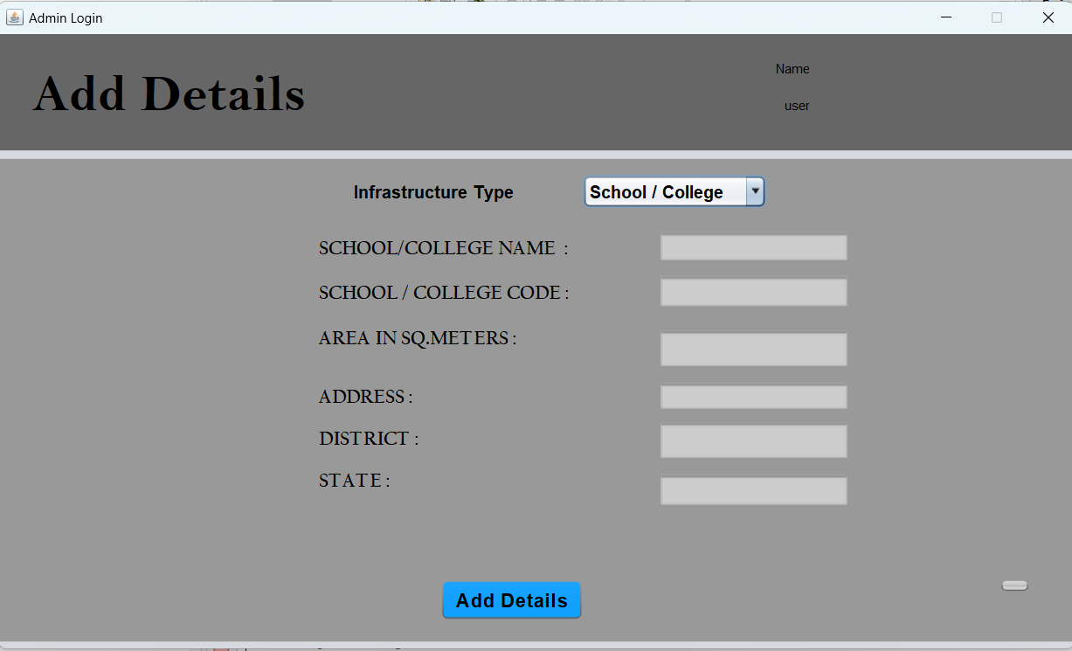
School:

Slide 19
Sub Modules under Infrastructure
Roads: The government agency responsible for roads will award a contract to a qualified contractor through a competitive bidding process. The contractor will be selected based on their experience, qualifications, and proposed bid amount and the contractor will add the details of the roads like ( Governement-which government taken up the project, Location, Area in Square meters, Budget, District State etc.) and also the contractor will be responsible for managing the project, including scheduling, budgeting, and overseeing subcontractors and workers. They will also be responsible for ensuring that the construction site is safe and secure, and that all work is done in compliance and regulations.

Slide 20
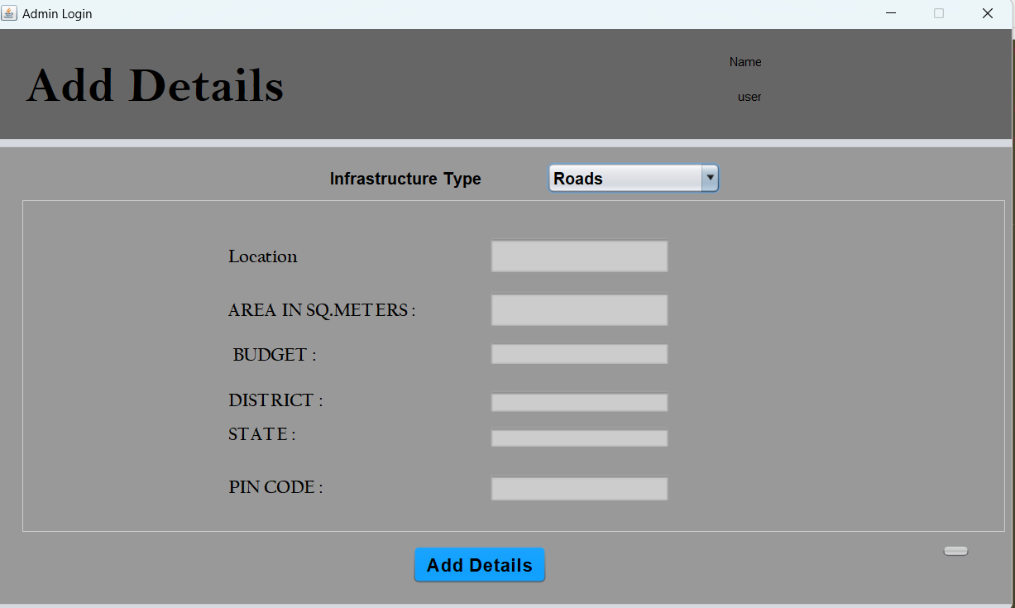
Roads:

Slide 21
Sub Modules under Infrastructure
Hospitals: The government agency responsible for healthcare will award a contract to a qualified contractor through a competitive bidding process. The contractor will be selected based on their experience, qualifications, and proposed bid amount and the contractor will add the details of the Hospital like ( Government-which government taken up the project, Location, Area in Square meters, Budget, District State etc.) and also the contractor will be responsible for managing the project, including scheduling, budgeting, and overseeing subcontractors and workers. They will also be responsible for ensuring that the construction site is safe and secure, and that all work is done in compliance with local building codes and regulations. Additionally, the contractor may need to comply with medical and healthcare regulations, such as those related to sanitation, infection control, and patient safety.

Slide 22
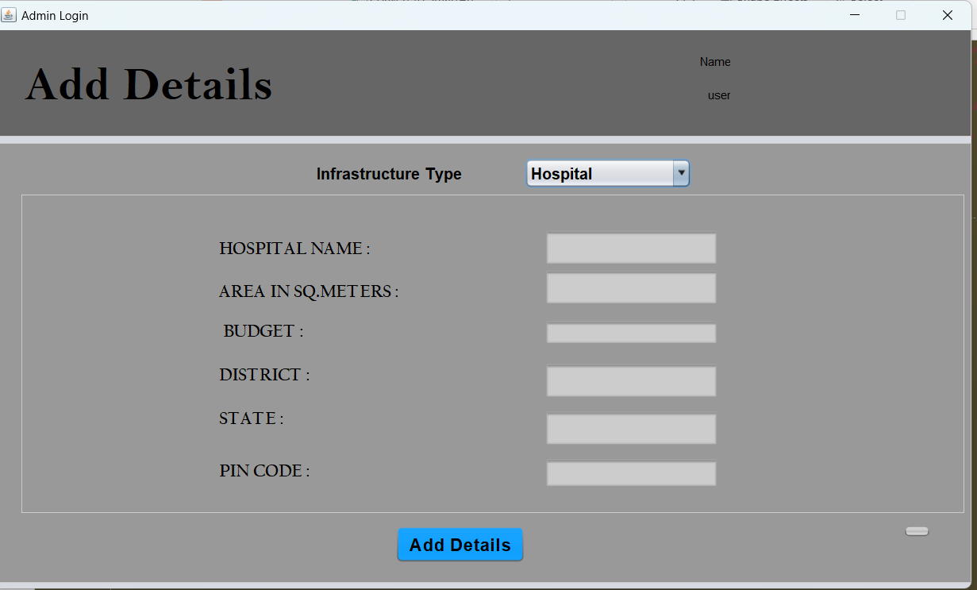
Hospitals:

Slide 23
Services Module Description
In the “Smart city” Project we can utilize the services like Aadhar card updation, Pan Card apply, Driving license registration we can use all these services in the desktop application this services become more efficient, liveable for their residents. By leveraging technology and data, cities can provide better services and improve the overall quality of life.

Slide 24
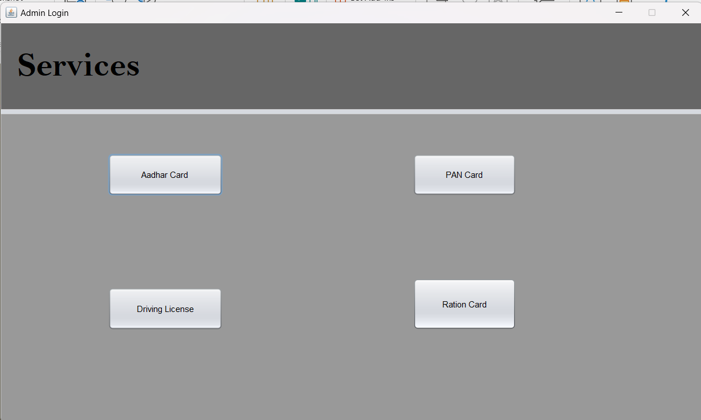

Slide 25
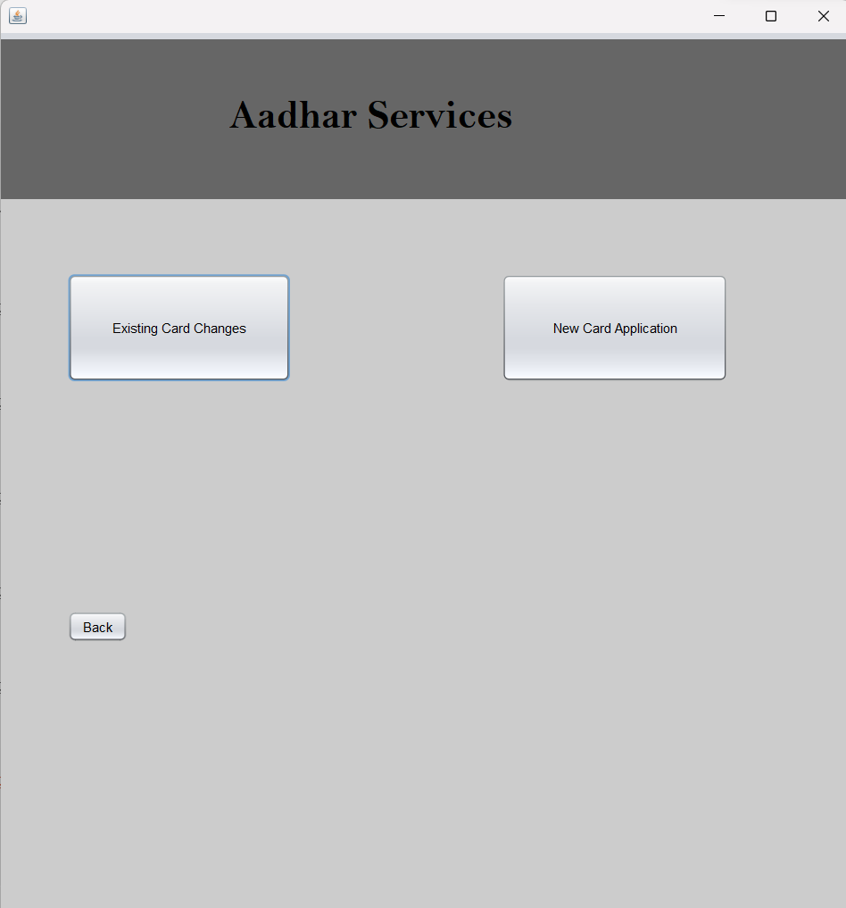
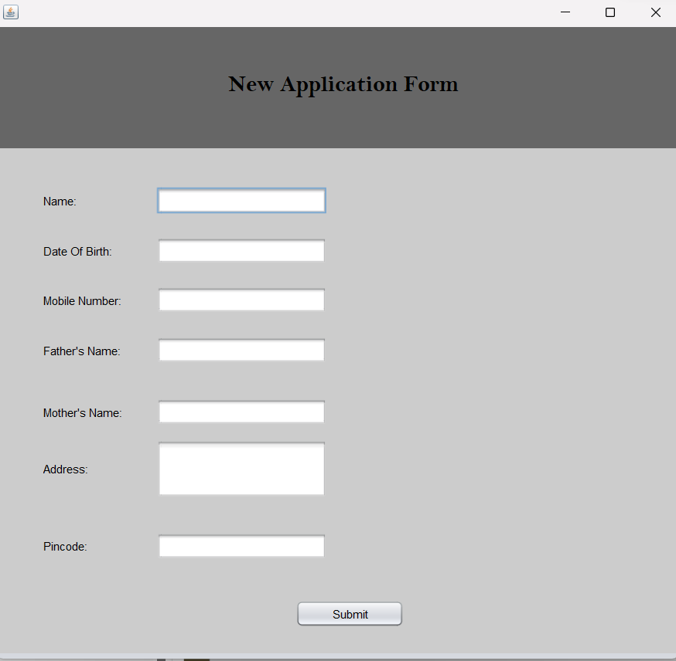

Slide 26
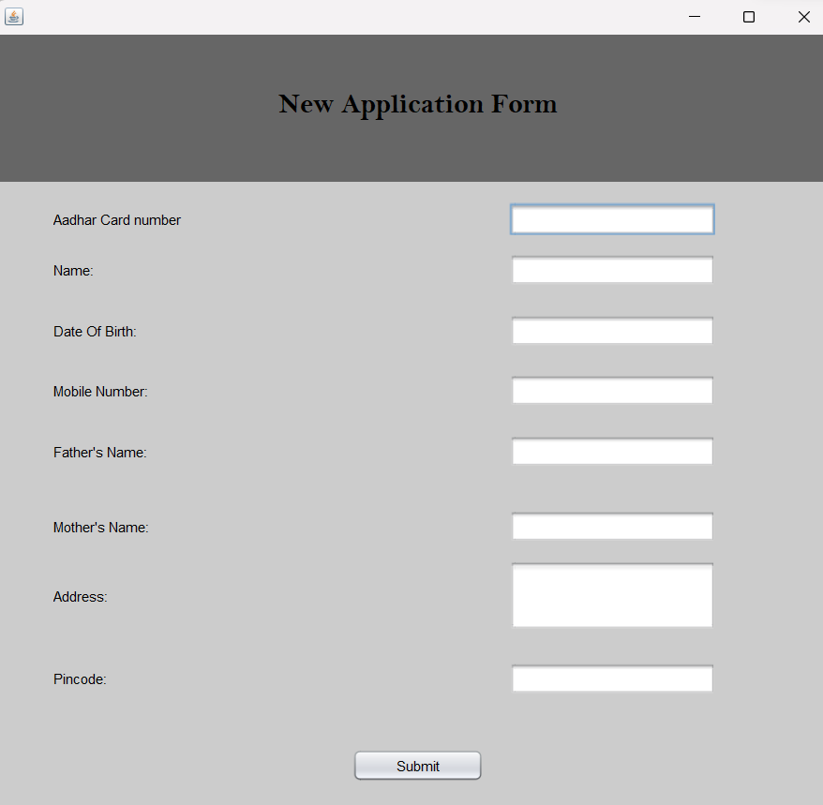
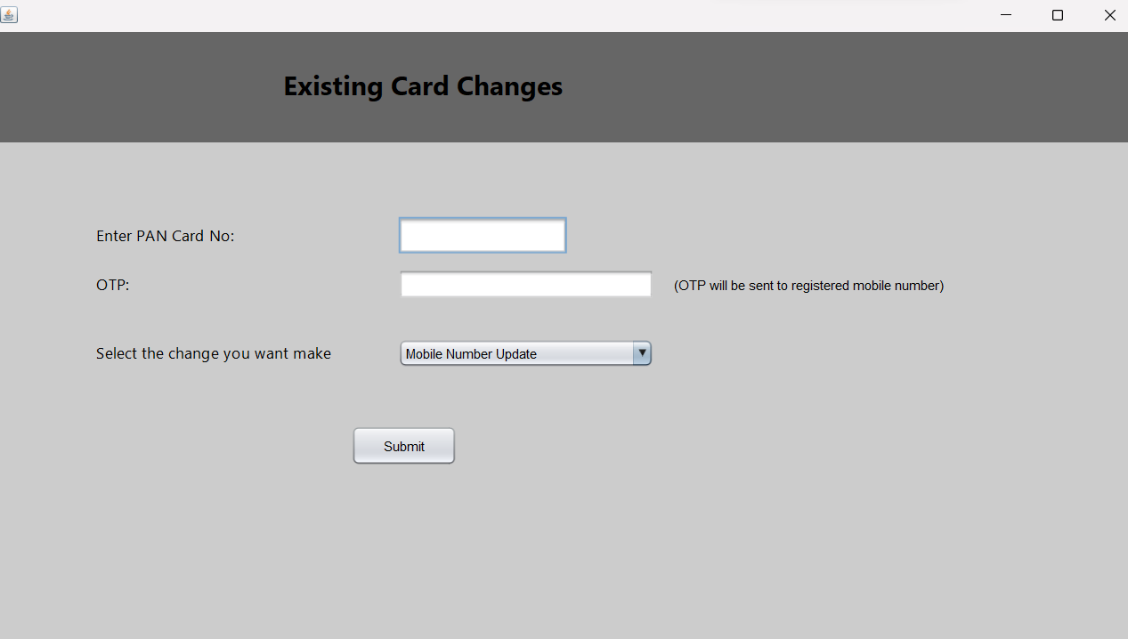

Slide 27
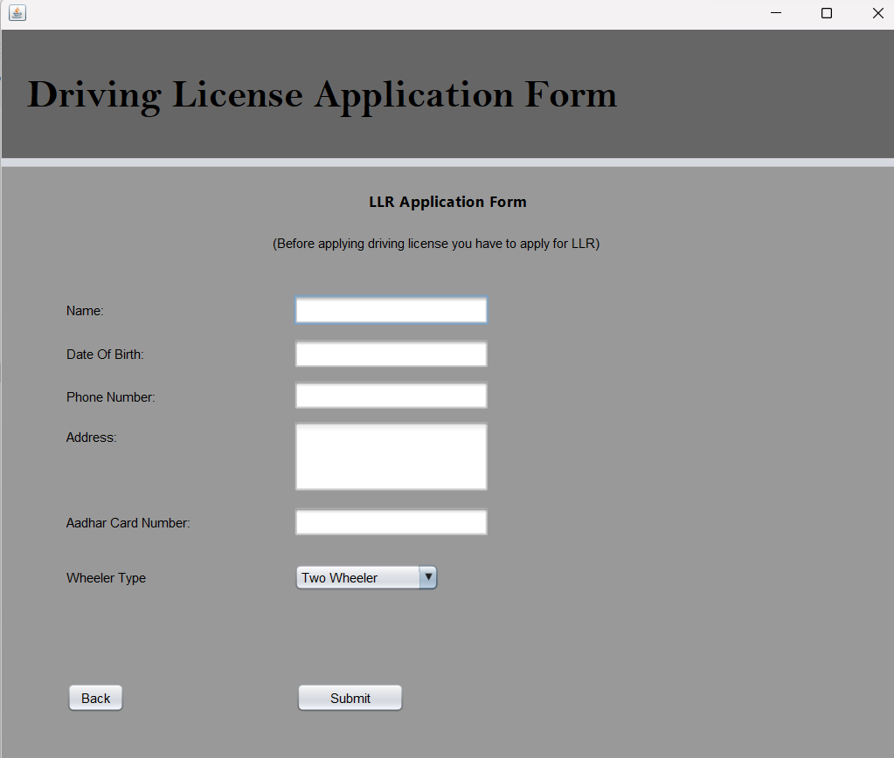
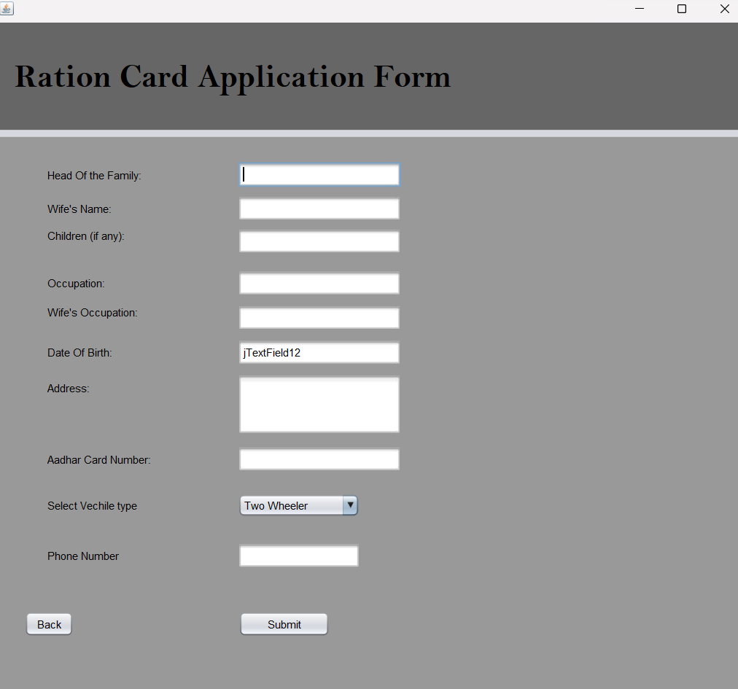

Slide 28
Thanking You

